Slide 1

TrustNet AI Technical presentation
BYTE BUILDERS

Slide 2
INDEX
1.Short introduction : What the code is supposed to do?
2.Technologies used
3.Code Walkthrough
4.Future improvements.

Slide 3
The python script has an integrated OpenAI API with GPT-3.5-turbo model.
The script is going to take send an request to the API with a prompt which contains the mail message with the Sender address and the content + some additional questions used to ask the AI if the mail is a malicious mail (maybe it has an attachment with a strange executable file) or a phishing email.
The API sends an response and the script takes it, uses some functions or some programs we wrote to crop the response message of the AI from the ‘raw’ data.
Then, we can create a feedback loop back to the mailbox, and delete or quarantine the mail.

Slide 4
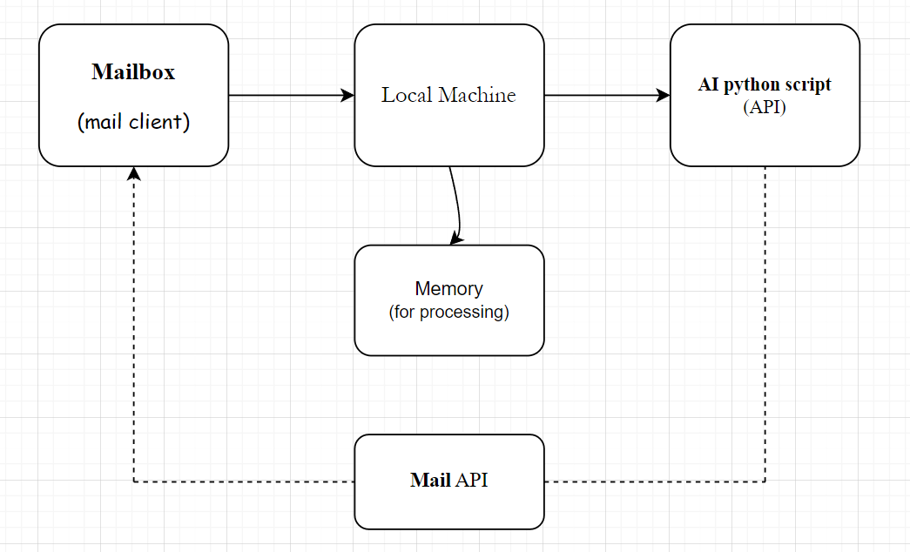

Slide 5
We choosed to use Python interpreter to create scripts for AI management and for API interaction.
The scripts embedds IMAP protocol function to send and retrieve data from a mail client.
Mail client uses outlook mail services.
Also, we created a very simple UI using HTML, so we can display the AI response.

Slide 7
Future improvements
We would like to add more code and ideas to our project, like an Mail API, API URL Scanner (for advanced phishing email detection), UI to have full control over the mailbox (we would like to copy all the mails to a separated environment where we are able to control, delete or modify all the mail, also this requires some web design skills we are developing now. ☺

